Slide 1
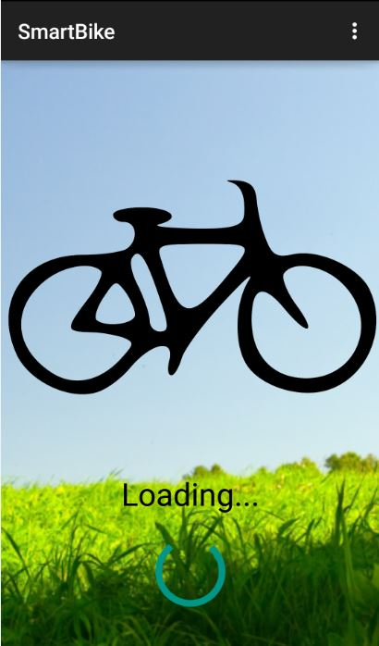

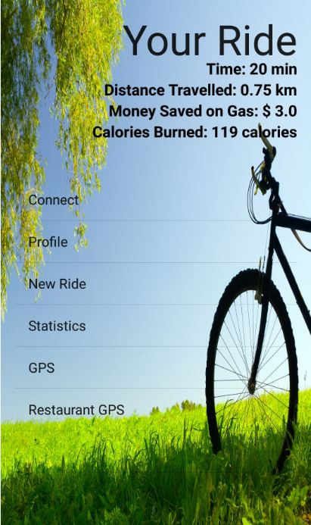
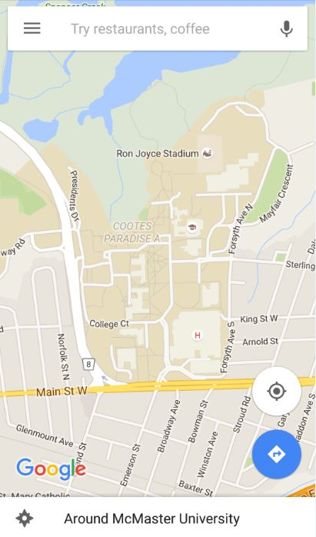
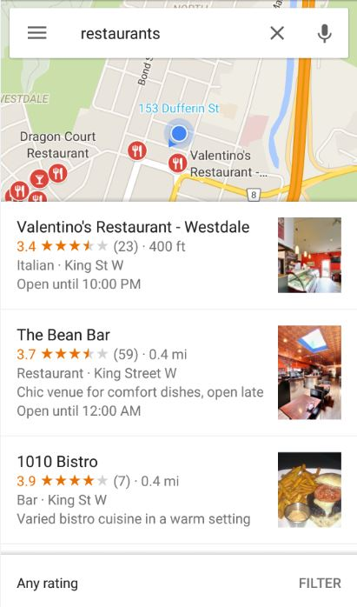
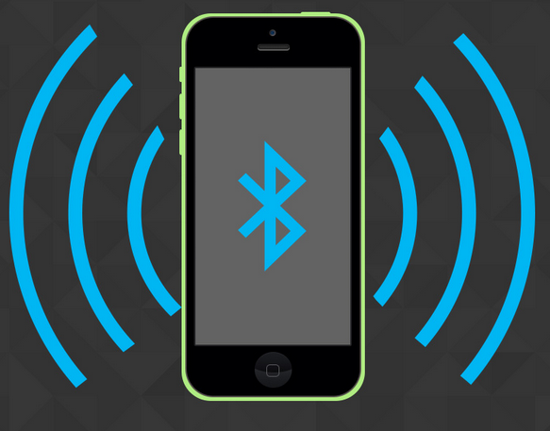
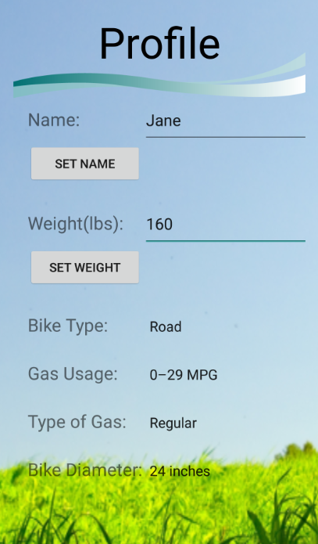

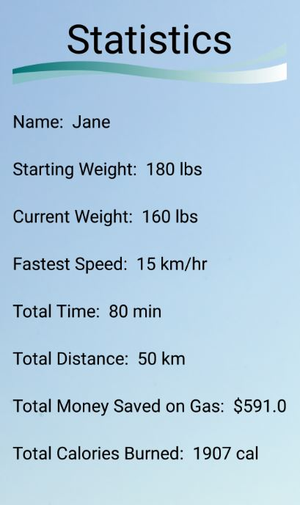
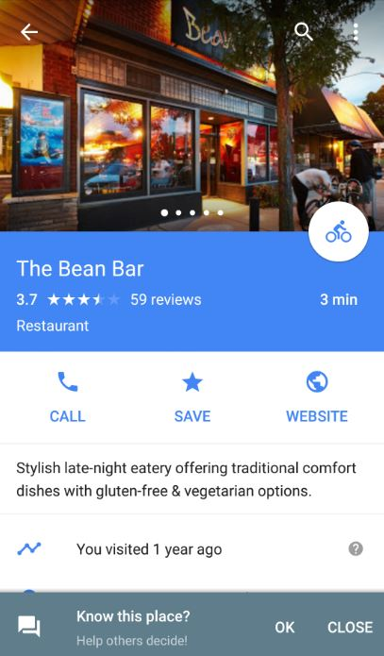
LoadActivity
Default launch activity started
‘Restaurant GPS’ provides local restaurants
‘GPS’ launches Google Maps
5 second timer
GPS Intent
GPS Intent
User
MenuActivity
onClick() to select Menu option
‘Connect’ launches BaseActivity to establish a Bluetooth connection
‘Profile’ launches ProfileActivity
‘New Ride’ resets values of current ride
‘Statistics’ launches StatsActivity
Bluetooth Connect
ProfileActivity
New Ride
StatsActivity
Google Maps setting is changed to bicycle route for user

